Slide 1
Decoding Human Emotion: An Introduction to Sentiment Analysis
How computers learn to read between the lines

Slide 2
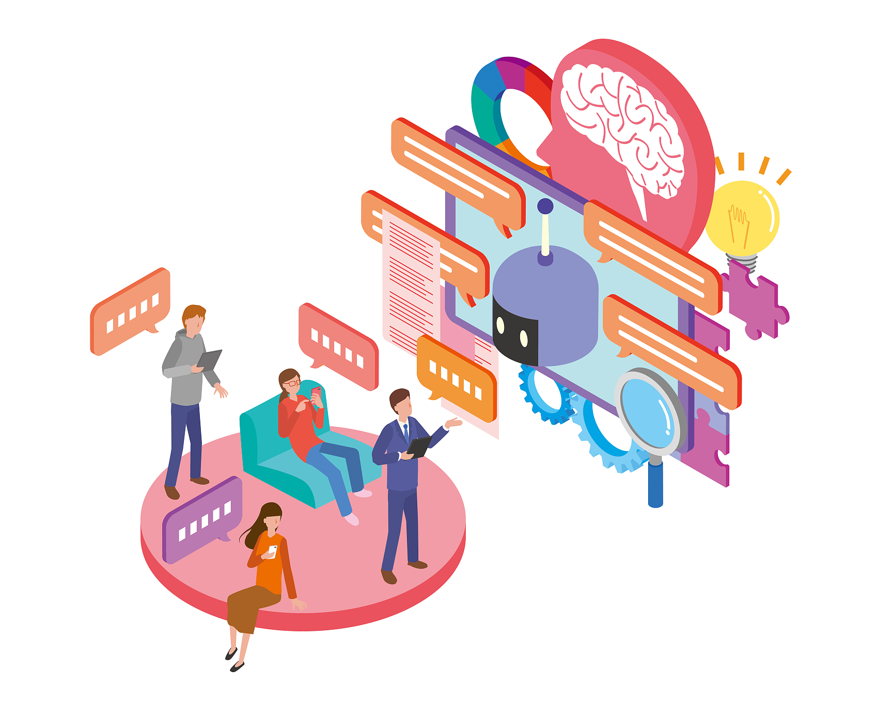
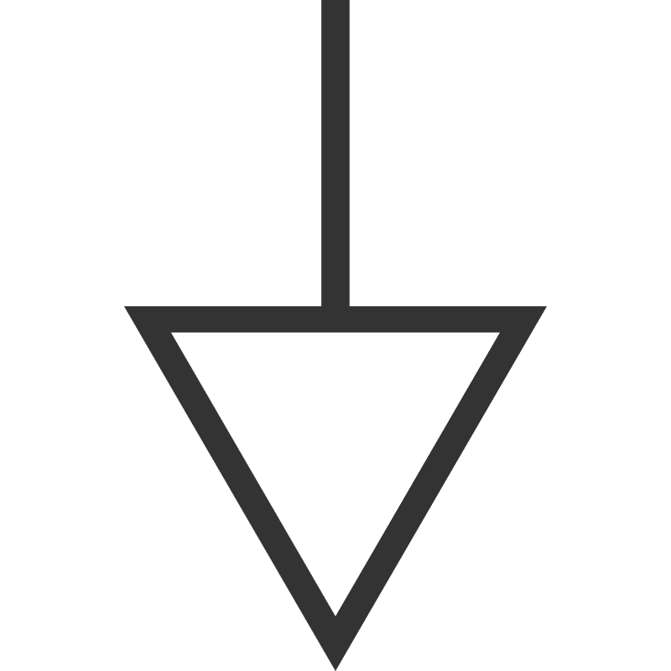
What is a Sentiment Analyzer?
Definition: A branch of Natural Language Processing (NLP) that identifies emotional tone in text.
Also known as: "Opinion Mining."
The Goal: To classify text into categories:
Positive (+1)
Negative (-1)
Neutral (0)
Input: Text (Reviews, Comments, Emails)
Output: Sentiment Score.

Slide 3
How Does It Work? (The Logic)
Step 1: Pre-processing: Cleaning the text (removing punctuation, lowercase conversion).
Step 2: Feature Extraction: Converting words into numbers the computer can understand (Vectors).
Step 3: Classification:
Rule-Based: Counting positive vs. negative words (e.g., "Good" = +1, "Bad" = -1).
Machine Learning: Training a model on thousands of examples to "learn" context.

Slide 4
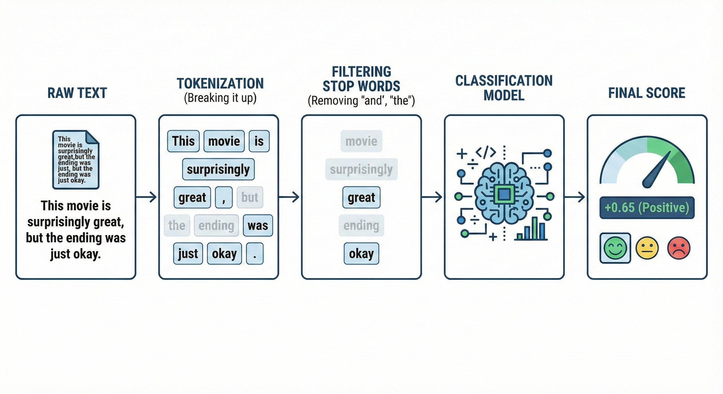

Slide 5
Real-World Applications
Business Intelligence: Analyzing product reviews to fix defects.
Social Media Monitoring: Tracking brand reputation in real-time.
Customer Support: Prioritizing angry emails or tickets automatically.
Finance: Predicting stock market trends based on news sentiment.

Slide 6
Challenges & Limitations
01
Sarcasm & Irony: "Great, my phone broke again!" (Computer might see "Great" and think it's Positive).
02
Context: "The movie was sick!" (Is "sick" good or bad?).
03
Negation: "I do not dislike this movie." (Double negatives are hard for simple models).
04
Multilingual Text: Handling slang and mixed languages (e.g., Spanglish).

Slide 7




Conclusion
Summary: Sentiment analysis turns unstructured text into actionable data.
The Future: Moving beyond Positive/Negative to detecting specific emotions (Anger, Joy, Fear, Surprise).
Key Takeaway: As AI gets smarter, it will understand not just what we say, but who we are.

Slide 8
Deep Dive: The DistilBERT Model
Model Name: distilbert-base-uncased-finetuned-sst-2-english
Source: Hugging Face Hub
Family: Transformer (Distilled version of BERT)
Key Architecture Features:
"Distil": Lighter & Faster.
40% smaller, 60% faster, retains 97% of performance.
"Uncased": Case-insensitive.
Treats "Good" and "good" exactly the same.
"Fine-tuned": Specialized Training.
Trained on SST-2 (Stanford Sentiment Treebank) to excel at binary classification (Positive vs. Negative).

Slide 9
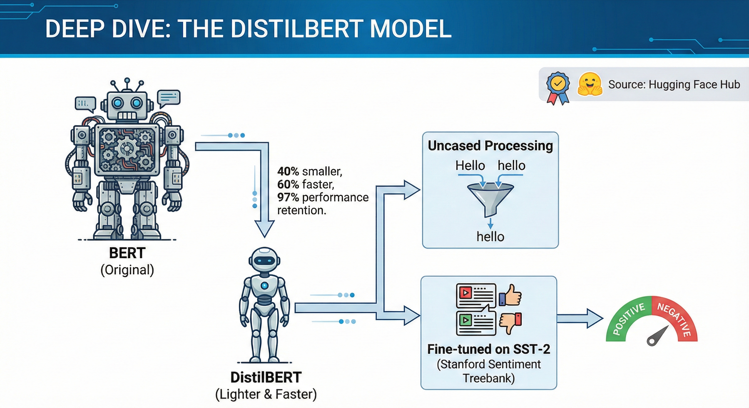

Slide 10
THANK YOU

